Slide 1
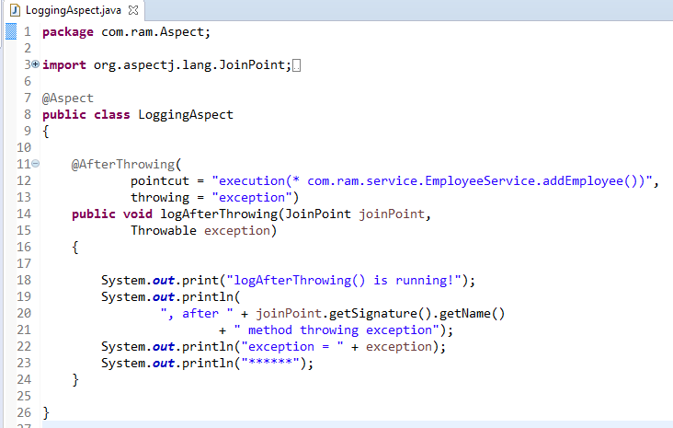
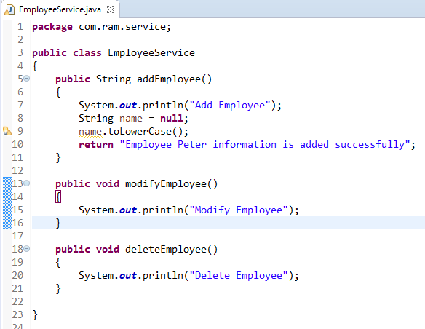
AspectJ @AfterThrowing
method
@AfterThrowing declares the throws advice.it is executed if actual method throws an exception.
@AfterThrowing
AspectJ “pointcuts” is used to declare which method is going to intercept
1
2

Slide 2
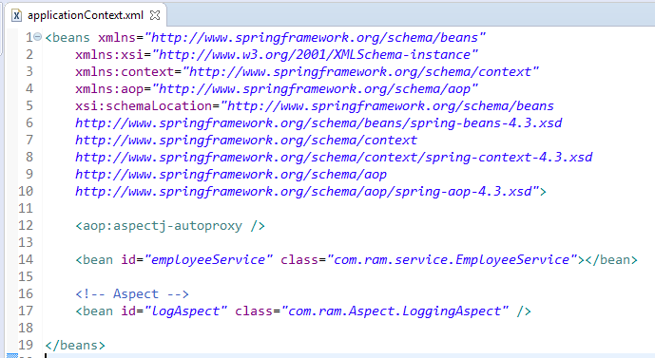
To Enable AspectJ, In Spring configuration file, put “<aop:aspectj-autoproxy />“, and define your Aspect (interceptor) and normal bean

Slide 3
